Slide 1
Network Diagram Icons
Cybersecurity

Slide 2

Cloud
Internet

Slide 3




Firewall

Slide 4

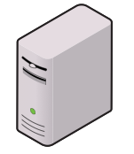



Hosts

Slide 5

Layer 3 Switch

Slide 6


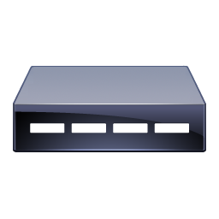

Modem

Slide 7



Router

Slide 8

Server

Slide 9




Switch

Slide 10


Users

Slide 11



Virus / Exploit

Slide 12

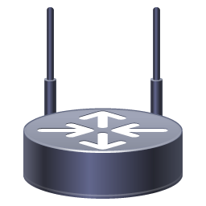

Wireless AP

Slide 13
Wireless AP

